Slide 1
Restorative Composition Pedagogy
Cynthia Mwenja, PhD
Assistant Professor of English
University of Montevallo Department of English and Foreign Languages
cmwenja@montevallo.edu

Slide 2
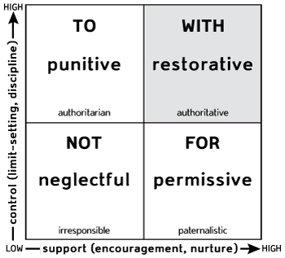
With
Restorative Composition Pedagogy cmwenja@montevallo.edu

Slide 3
Restorative Practices
Conflict Resolution Tools
Proactive
Create an inclusive and egalitarian community which welcomes every individual
Responsive
Respond to harms done or conflict within the community
Restorative Composition Pedagogy cmwenja@montevallo.edu

Slide 4
“With” as Epistemology create community, repair as needed, improve when possible
Does this element of my semester plan, syllabus, or personal interaction style work to create community?
Does the element repair harms done in this classroom or previously?
Does this element improve the classroom or the larger community?
Restorative Composition Pedagogy cmwenja@montevallo.edu

Slide 5
Restorative Composition Practices
Inclusiveness, egalitarianism, and respect permeate curriculum and classroom activities
Students participate in classroom decision-making and help to define standards
Goal of mitigating harms done in previous composition classes
Restorative Composition Pedagogy cmwenja@montevallo.edu

Slide 6
Positionality
White
American
Southerner
Cis-gender
Female
Lower middle class
Progressive
Middle aged
Mother of 5 mixed-race girls
Wife of Kikuyu tribesman
Sister of homosexual man
Restorative Composition Pedagogy cmwenja@montevallo.edu

Slide 7
Research Methods
Classroom case study
Qualitative
Survey data
Restorative Composition Pedagogy cmwenja@montevallo.edu

Slide 8
Semester Plan
Classroom Activities
Individual and collaborative writing
Small and large group discussions
Focus on student writing
Classroom functions as ongoing circle
Units
Language Diversity
Literacy Narrative
Civil Rights Response Project
Restorative Composition Pedagogy cmwenja@montevallo.edu

Slide 9
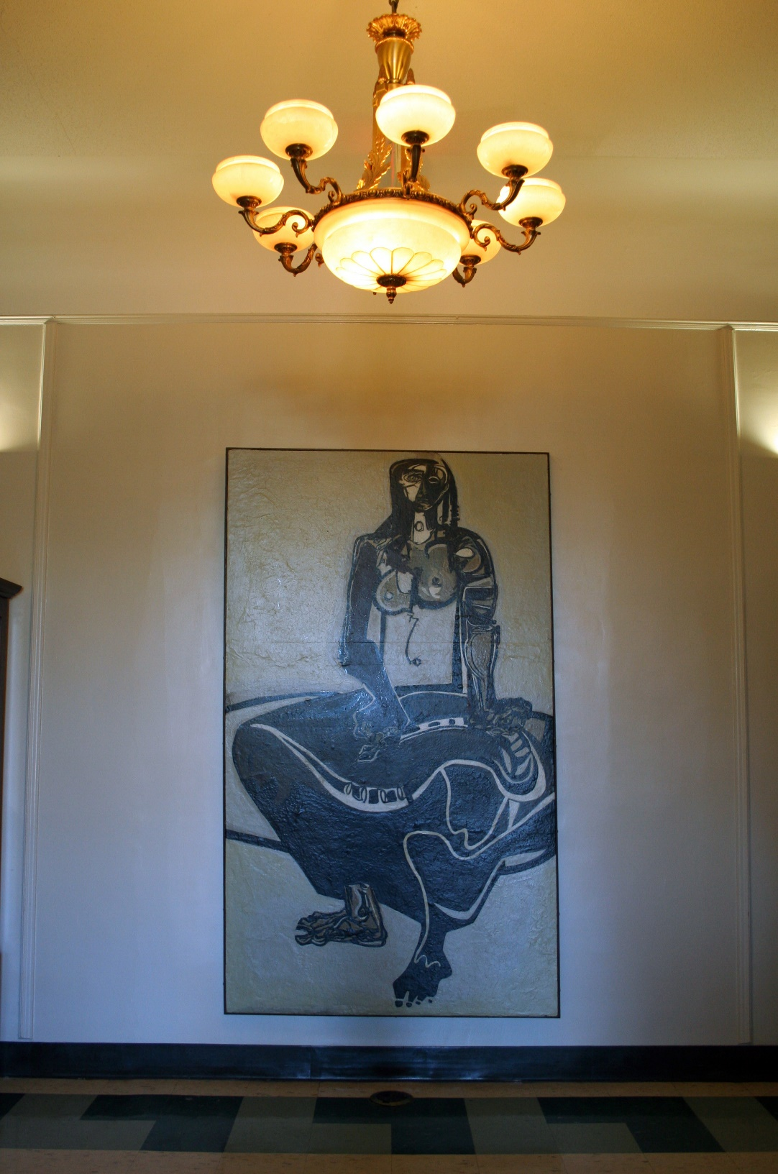
Entry to English Department
Restorative Composition Pedagogy cmwenja@montevallo.edu

Slide 10
Classroom Map
Door
Window
Computer Podium
Window
Class computer storage
Computer Projector Screen
Restorative Composition Pedagogy cmwenja@montevallo.edu

Slide 11
Demographics
8 female, 16 male
Majority identified as white Americans, with 2 Black students and 1 international student
About half from the South and half from other parts of the United States
Majors across the spectrum
Restorative Composition Pedagogy cmwenja@montevallo.edu

Slide 12
“Working Successfully with young people”
“Three things need to be present:
Support
(teaching explicitly what is needed)
High expectations
(pressure that comes from a relationship of mutual respect), and
Insistence
(the motivation and persistence that comes from a relationship of mutual respect)”
Thorsborne and Blood, 34
Restorative Composition Pedagogy cmwenja@montevallo.edu

Slide 13
Moments
Beginning of the semester
Before and after class
Office hours
Unprepared students

Slide 14
Pre-semester Survey
Half feel good about writing
Half like English class
Half appreciate the field of English
Typical array of attitudes and previous experiences
Restorative Composition Pedagogy cmwenja@montevallo.edu

Slide 15
Post-semester Survey
Students
Reported improved communication abilities
Felt comfortable, welcome, respected, and included
Felt that classroom challenges were handled justly
Believed the class met individual needs
Believed the course met the needs of the class as a whole
Felt we handled tough topics well
Restorative Composition Pedagogy cmwenja@montevallo.edu

Slide 16
Student Feedback
“This class … inspired me to become a better researcher, writer, and human being”
Marley

Slide 17
Restorative Composition Pedagogy
Cynthia Mwenja, PhD
Assistant Professor of English
University of Montevallo Department of English and Foreign Languages
cmwenja@montevallo.edu

