Slide 1
Effecting Change Through Dialogue within a Model of Self-Regulated Learning
Jodie Hemerda, Ph.D.
Lifelong Learner

Slide 2
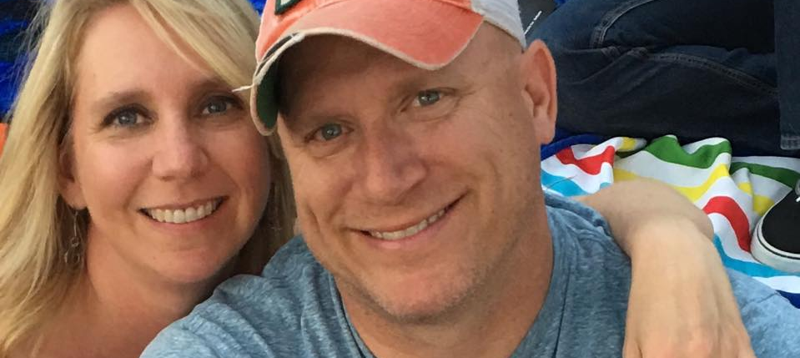
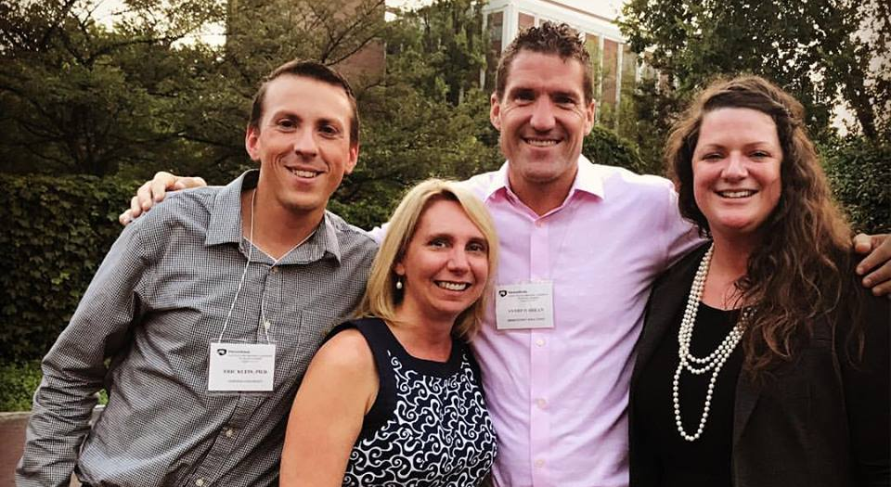
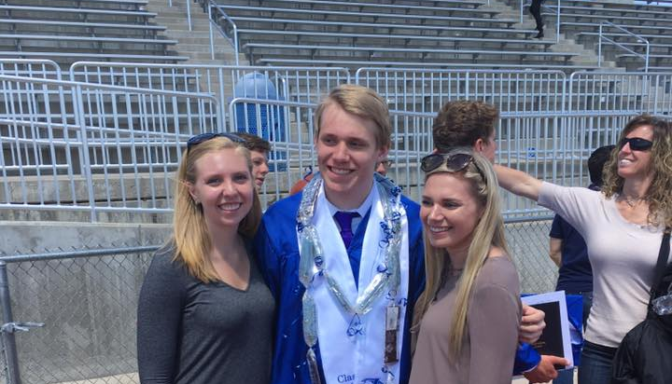
I AM…
Professional Career:
  2010-current Director in Academic/Curricular Operations
  2001-2006 Social activist/educational social justice website and newsletter founder/editor
  1992-2000 Start-up business partner - temp and emergency back-up child/elder care placement
Education History:
  Ph.D. Education, educational technology
  Graduate Certificates:
    Adult Learning
    Peace, Social Justice and Reconciliation
  Master of Liberal Studies with Psychology emphasis
  Bachelor of Physical Science with minors in Mathematics and Statistics

Slide 3
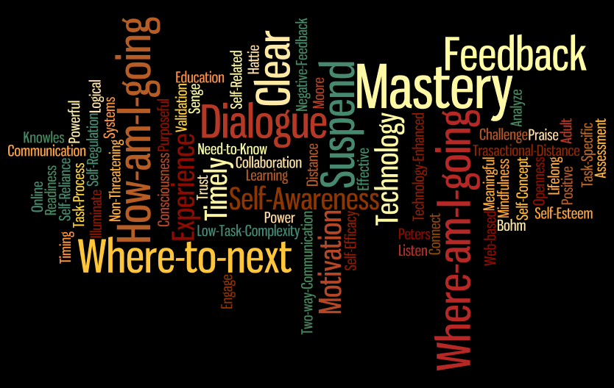

Slide 4
You ARE…
I invite you to share your name, and something you’d like us to know about you.

Slide 5

The organism has one basic tendency and striving - to actualize, maintain, and enhance the experiencing organism. - Carl Rogers
Notes:
I’m new to Restorative Practice… or am I? I’ve always felt that life had a way of taking care of me. Some of my worst experiences led the best – moving at 15, I met my husband.

Slide 6
Of all the conferences…
OLC Innovate 2016
EdMedia 2016
Site 2016
ILA LEA 2017
ACE COIL 2017
InstructureCon 2017
IELOL 2017
TLC 2017
USAFA SoTL 2017, 2016, 2015, 2014
IIRP 2017
TLTS 2016, 2015
CIBER 2016

Slide 7

When a person realizes he has been deeply heard, his eyes moisten. I think in some real sense he is weeping for joy. It is as though he were saying, "Thank God, somebody heard me. Someone knows what it's like to be me”. - Carl Rogers

Slide 8
Why are we here?
Want to engage learners to effect change in their internal self-regulatory processes? As a powerful form of communication, dialogue provides a key! In this session, Dr. Hemerda will identify key components within the self-regulated learning model and the effectiveness of dialogue to deepen learning. Learn how dialogue can be used to intervene against the obstacles that beliefs and preexisting knowledge play in the ability of a learner to accept new concepts and delve into a deep cycle of learning. Participate in an engaging dialogue to practice your newfound skills.

Slide 9
What do we hope to accomplish?

Slide 10
Learning Outcomes
Identify key components within the self-regulated learning model.
1
Describe the use of dialogue to deepen learning.
2
Consider instructional feedback as a method of dialogue.
3
Practice dialogue.
4

Slide 11
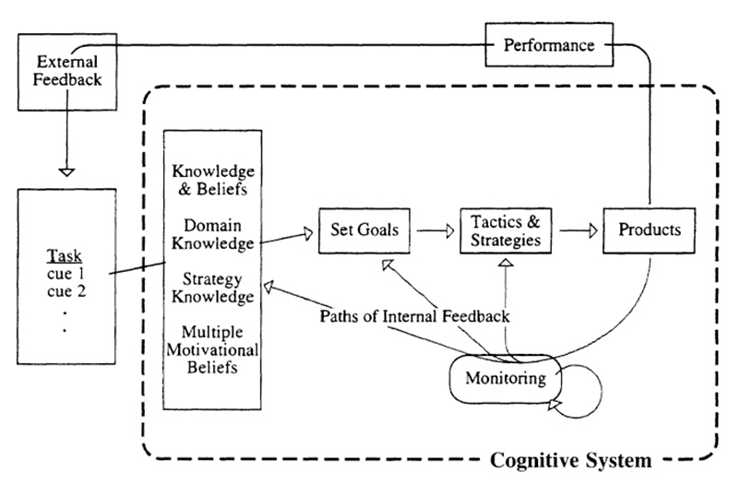
Self-regulated Learning Model
SRL is inherent in knowledge construction….Monitoring is the hub of self-regulated task engagement and the internal feedback it generates is critical in shaping the evolving pattern of a learner’s engagement with a task. (Butler & Winne, 1995, p. 275)
Butler & Winne, 1995 Model
Notes:
1

Slide 12
Self-regulated Learning in Teaching
Expert teachers engage students in learning and develop in their students self-regulation, involvement in mastery learning, enhanced self-efficacy, and self-esteem as learners” (Hattie, 2003, p. 10).
Butler & Winne, 1995 Model
Notes:
1

Slide 13
Self-regulated Learners
Self-regulated learners possess self-awareness.
Feedback serves as a “catalyst” to self-regulation (p. 246).
“Effective learners seek out external feedback” (Butler & Winne, 1995, p. 246).
Butler & Winne, 1995 Model
Notes:
1

Slide 14
Share your experience with the SRL Model.
Notes:
1

Slide 15
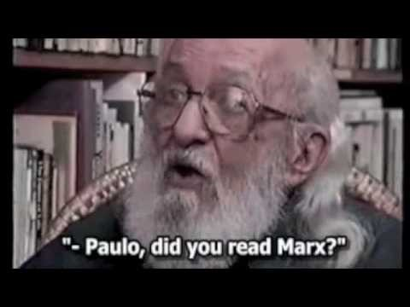
Paulo Freire, Brazilian Educationist, (1921 - 1997)

Slide 16
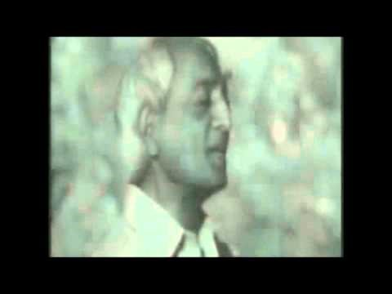
Learning does not mean starting with a certain amount of knowledge, and adding to it further knowledge. That is not learning at all; it is a purely mechanistic process. To me, learning is something entirely different. I am learning about myself from moment to moment, and the myself is extraordinarily vital; it is living, moving; it has no beginning and no end. When I say, 'I know myself,' learning has come to an end in accumulated knowledge. Learning is never cumulative; it is a movement of knowing which has no beginning and no end. (Krishnamurti, 1995, p. September 20)
2:11

Slide 17

Peter Senge, MIT
When we’re learning something new, we can feel awkward, incompetent, and even foolish. It’s easy to convince ourselves that it’s really not so important after all to incorporate the new – and so we give up. This is our own psychological “immune system” at work. (Senge et al, 2004, p. 35)

Slide 18

Peter Senge & Otto Scharmer, MIT, U Process
Notes:
1:10

Slide 19
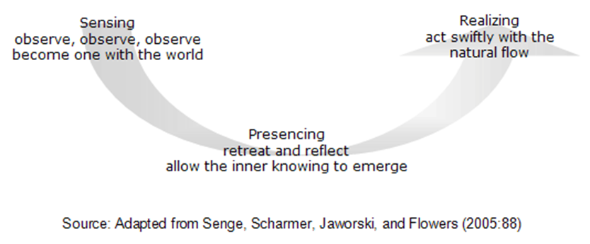
U Process: Suspend for deep learning
Sensing: deep, inquiry into their mental models through seeing reality beyond their filters;
Presencing: moving from there to a deep process of connecting with purpose and visioning, individually and collectively;
Realizing: then moving into rapid prototyping to translate visions into concrete working models from which feedback can be garnered and further adjustments made. (Senge, 2006, Appendix 3)
Notes:
2

Slide 20
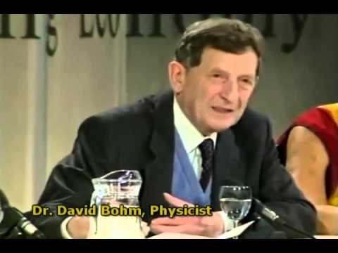
David Bohm, Quantum Physicist & Philosopher, (1917 – 1992)
Notes:
2

Slide 21
What seems familiar?
What is new?
What more would you like to know?
Notes:
1,2

Slide 22

Power of Dialogue
Suspend assumptions
Improve the quality of conversation
Provide an avenue to mutual discovery
Notes:
2

Slide 23

Conversion to Dialogue
Attentiveness to specific contexts,
A flow of energy between reflection and engagement or action,
Posing problematic situations,
Sensitivity to power relations. (Boys, 1999, p. 134)
Notes:
2

Slide 24

Purpose: Create shared meaning
Dialogue as a process of liberating discovery occurs multidimensionally, bringing new understanding of persons, places, events, and community; it is the invention of new thought… Originating new thought is the core of dialogical encounter… When all involved are focused on communicating coherently in truth, the formation of new thought and action holds the potential of seeing the familiar in a new way. (Bunkers, 2000, pp. 212-213).
Notes:
2

Slide 25

Rules of Engagement
Bohm (Bohm & Edwards, 1991; Bohm & Nichol, 2004) brought groups of up to forty individuals together to:
actively engage thinking
build trust
suspend presumptive thought
openly listen
work toward creating shared meaning
Notes:
2

Slide 26

Guidelines for Dialogue
Persistence
Presence
Open
Tacit
Emergent
Engaged participation through voice
Previous knowledge or experience
Create shared meaning and new insights
Balance of power
Notes:
2

Slide 27

Environment
Safe
Bias-free
Harmonious environment
Notes:
2

Slide 28
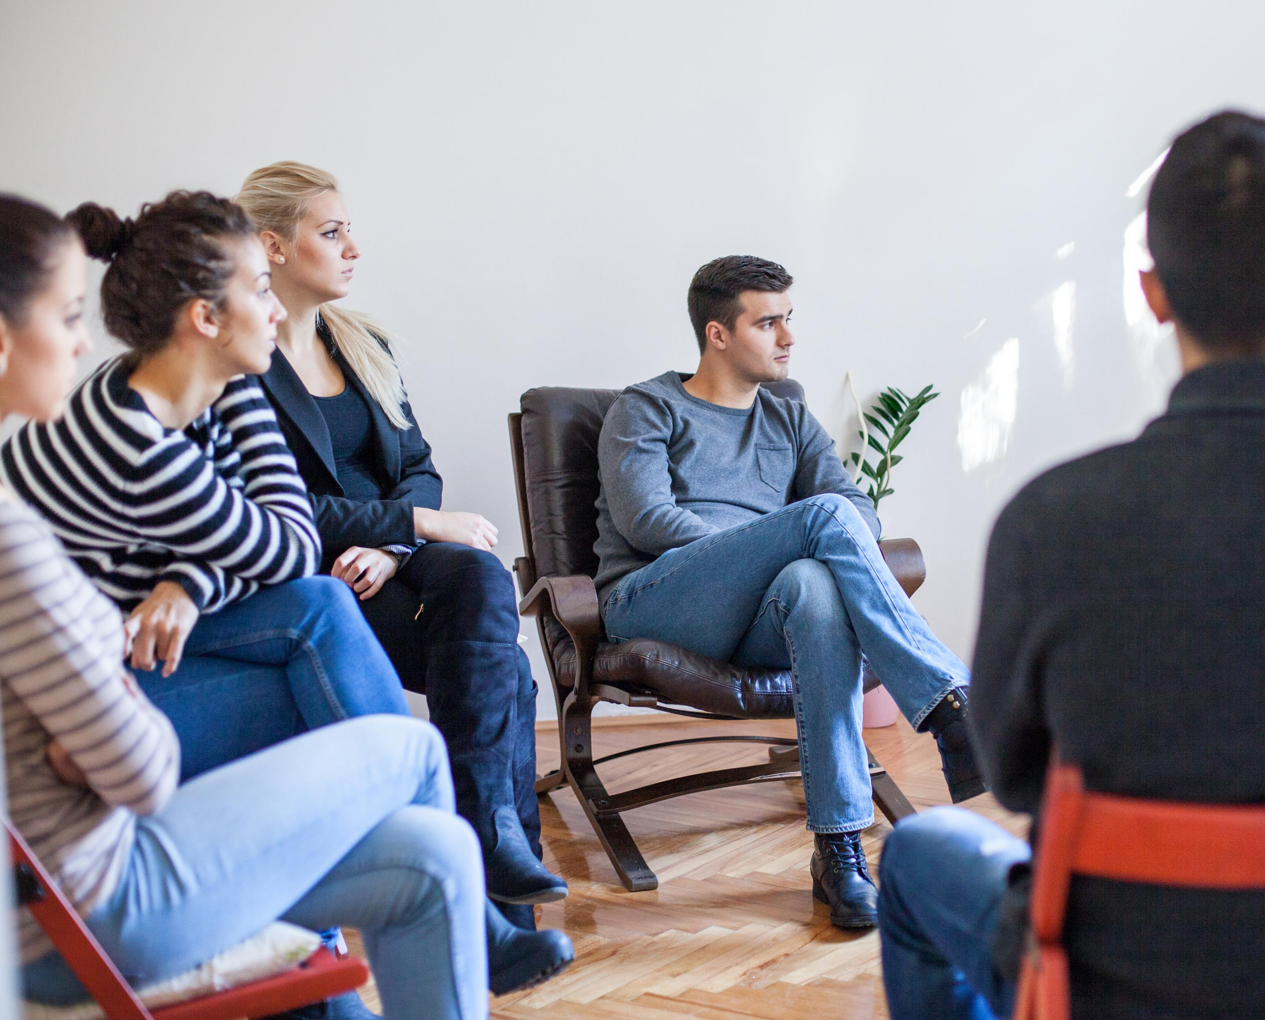
Facilitation Guidelines
Collaboration
Effective questioning
Transparency
Authenticity
Training
Notes:
2

Slide 29
Compare and contrast Bohm’s version of dialogue with Restorative Practice.
What’s your greatest take away?
What more would you like to know?
Notes:
1,2

Slide 30

Where to now?
Instructional feedback presentation for teachers
Technology delivered feedback for online learners
Maximizing feedback for self-regulated learning

Slide 31
