Slide 1
Challenges in Sustaining Restorative Justice: Lessons from Northern Ireland
Tim Chapman
Ulster University

Slide 2
Restorative justice in Northern Ireland: origins

Slide 3
Northern Ireland: set up
The 2002 law makes restorative justice mandatory
Restorative conferences bring together all those who have a stake in repairing the harm to the victim and supporting the young person to have a better life.
Facilitated by full time practitioners in the Youth Justice Agency trained by Ulster University.
Well resourced
Strong leadership

Slide 4
The Balanced Model
Community
Harm
Person responsible for harm
Injured party
Through narrative dialogue

Slide 5
Outcomes for Youth Conferences
Number of youth conferences now over 20,000
Over 100,000 people have participated in a youth conference
Victim attendance; 50/70%
Victim and young person satisfaction ; 90% and 95
26% serious or very serious offences, 53% intermediate, 21% minor
94% successful completion of plans
Reoffending 35.4 % (22% for serious harm)
Reoffending for all other community disposals 53.5%; for custody 68.3%
England and Wales put over twice as many young people into custody as Northern Ireland

Slide 6
On the other hand
There is now considerable evidence that institutional needs regularly over-ride the needs of the people that the institution is designed to serve (Pavlich 2009, Hoyle and Rosenblatt 2016, Bolivar 2015, Choi et al 2013, Zernova 2007, Choi and Gilbert 2010, Hoyle et al 2002, Strang 2002, Barnes 2016, Bolivar, Pelikan and Lemonne 2015)

Slide 7
Drift
How creating value destroys values
Managerialism – strategic targets, performance indicators and cost cutting
Legalism – primacy of the offender, proportionality
Quality of delivery and experience become thinner

Slide 8
How can restorative justice be sustainable?
Is this the right question?

Slide 9
Fields
Society
Political and economic systems
Institutional context
Restorative justice
From whose vantage point
are we seeing the field?

Slide 10
The fundamental unifying hypothesis of restorative practices is that “human beings are happier, more cooperative and productive, and more likely to make positive changes in their behavior when those in positions of authority do things with them, rather than to them or for them.”

Slide 11
Integration through assimilation or accommodation?
Of what?

Slide 12
What are the major disruptions and disconnections in modern society?

Slide 13
The Problem: Disconnection
From nature
From others
From self

Slide 14
How to engage with social reality in motion? How do we make sense of and respond to the volatility, uncertainty, complexity and ambiguity of the world?

Slide 15
How do we understand, communicate and implement the quality and value of restorative justice?

Slide 16
“We can not solve our problems with the same level of thinking that created them” Albert Einstein Are we trying to solve today’s problems with yesterdays’ ideas?

Slide 17
Are we in a restorative bubble? How to enable our field to see itself?

Slide 18
The field of restorative practices
Elements of traditional communities whose rituals keep the peace;
Elements of therapeutic strategies to meet personal needs;
Elements of instrumentalist strategies to meet institutional needs;
Elements of relational, empathic dialogical processes engaging stakeholders;
Elements of collective creativity and action through eco-systems

Slide 19
Is injustice our blind spot?

Slide 20
Eleanour Rooseveldt said:
“Where, after all, do universal human rights begin? In small places, close to home - so close and so small that they cannot be seen on any maps of the world. Yet they are the world of the individual person; the neighbourhood he lives in; the school or college he attends; the factory, farm, or office where he works. Such are the places where every man, woman, and child seeks equal justice, equal opportunity, equal dignity without discrimination. Unless these rights have meaning there, they have little meaning anywhere. Without concerted citizen action to uphold them close to home, we shall look in vain for progress in the larger world.”

Slide 21
What is the source and focus of our attention and listening?

Slide 22
Are we present or absent?

Slide 23
Absence violates restoration
Fear, judgement and cynicism
Responsibility of the perpetrator
Vulnerability of the victim
Blaming and excluding
Closed mind
Echo chamber empathy
One truth
Denying other truths or lying
Closed will
One method
Closed heart
Separation

Slide 24
Presence generates restoration
What does it mean to be present?
Courage
Setting up
Showing up
Standing up
Curiosity
Looking out and upwards
Knowing you don’t know: letting solutions emerge
Prepared to have your assumptions and beliefs challenged.
Compassion
Seeing others’ suffering
Respecting others’ resilience and intelligence

Slide 25
What is the matter with you? Or What matters to you?

Slide 26
Who decides?
Referral
Participation
Outcomes

Slide 27
Our solution? connect, respect and protect
Connect people through their awareness of their participation in society and its impact on others and their awareness that they can act effectively in the common good.
Respect is generated through the reintegration of the visible material impact of behaviour and invisible internal processes.
Respectful relationships are the most effective means of protecting people from harm.

Slide 28
Conversation or interview?

Slide 29
Whose questions?
What questions arise for you out of what happened?
What requests do you have?

Slide 30
Listening for the truth through narrative dialogue
The facts of the event – forensic truth
The experience of the event – the narrative truth
The encounter of the narratives (the whole story) – the dialogical truth
The generation of new possibilities – the transformative truth

Slide 31
Restoring the future
An act of harm stimulates a narrative of suffering which interrupts and disrupts one’s chosen narrative.
Moving from a general public narrative to a specific personal narrative.
Moving from the specific personal narrative to a common more complete narrative.
Moving on with one’s chosen narrative.

Slide 32
A process of opening, deepening, completing and moving on.

Slide 33
Who owns restorative justice?
You can’t produce RJ.
You can’t order RJ.
You can’t buy RJ.
You can’t shape RJ.
You can’t own RJ.
You can’t give RJ.
You can only do it and be it.

Slide 34
Who is it who practices restoratively?

Slide 35
Practitioners’ invisibility and stillness
Create the conditions
And engage presence
And facilitate the process
Which lets people attend to harm and suffering
So that the outcomes that satisfy them emerge.

Slide 36
Restorative processes as scaffolding
Providing strong, safe platforms enabling people to
reach dangerous places and facilitating difficult work.

Slide 37
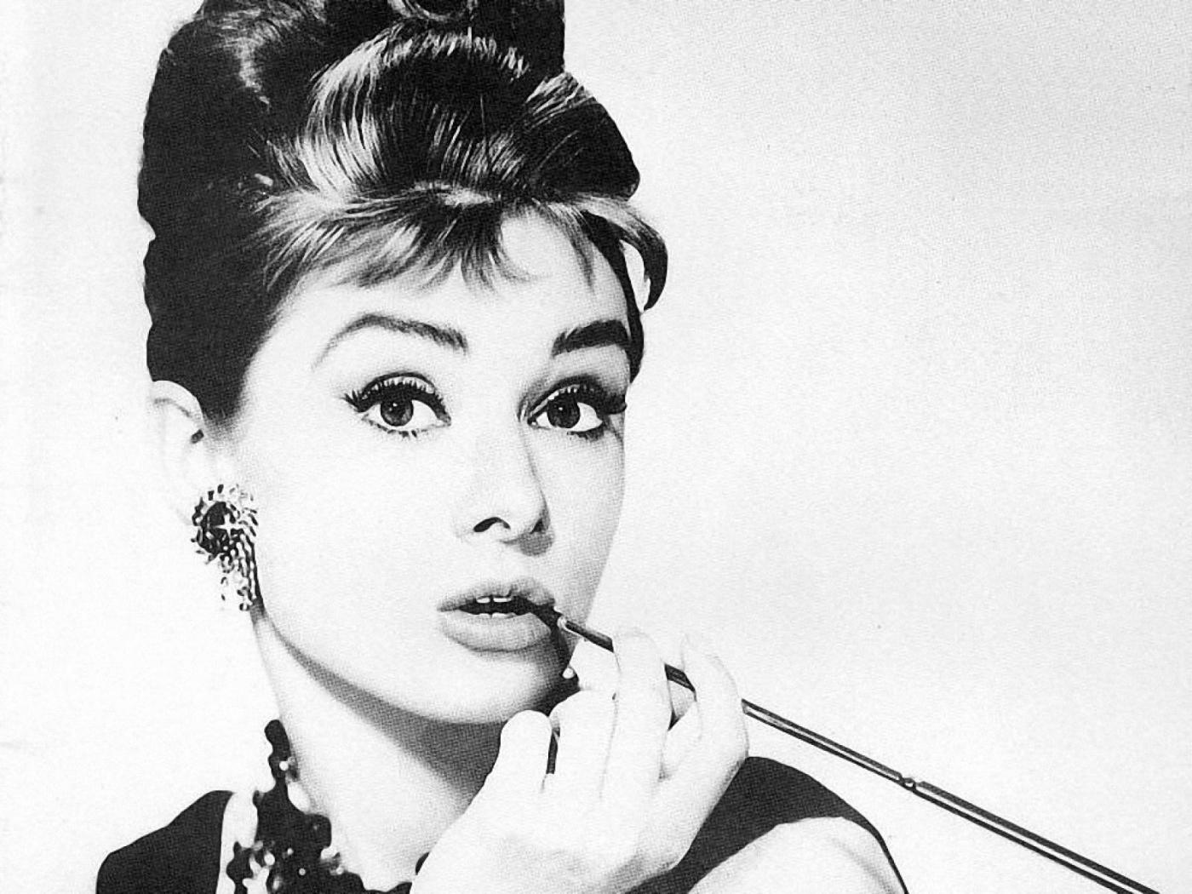
People, even more than things, have to be restored, renewed, revived, reclaimed, and redeemed; never throw out anyone.

Slide 38
Thank you
tj.chapman@ulster.ac.uk

