Slide 1
Racial Identity & Workplace Leadership IIRP: Sustainable Leadership: TEACH Toronto, Canada, 5/1/18 1530-1700
Lauren H. Mascari, MS, LPC-IT

Slide 2
Today’s Agenda
Intro
Self-concept
Social Identity
Racial Identity models
Intersectionality
Moving Forward

Slide 3
DISCUSS
Why did you choose to attend this session?

Slide 4
Assumptions
We care about social justice
We are human and apt to make errors, despite intentions
We have humility and are willing to critically reflect on our identity development
Identity development is a non-linear process
There are infinite ways to investigate our own racial identities (no finite, singular “correct” way)
By investigating our own biases, we can make better informed decisions
Calling you IN

Slide 5
Why is this important?
Increasing diversity in the workplace!

Slide 6
The best business/organizations know how to invest in their peoples potential
Canada’s most successful companies are its most courageous
Inclusion is the key to closing the gap
Accountability is what makes this process sustainable

Slide 7
EMIC ←→ ETIC
individual ←→ universal

Slide 8
Self concept: significantly regulates behavior
Markus & Wurf (1987)
Notes:
One of the most significant regulators of behavior
-dynamic interpretive structure that mediates most significant intrapersonal processes (info processing, affect, and motivation) and interpersonal processes (social perception, choice of situation, partner, interaction strategy, reaction to feedback)

Slide 9
DISCUSS
WHAT’S IN A NAME?
In small groups (3-4), share your full name
Where did you name come from?
What does it mean?
How was it decided?
What do you think about your own name?

Slide 10
Social IDENTITY: provides us with a sense of pride, belonging, and self-esteem
Tajfel & Turner (1986)
Notes:
Important sense of self-esteem and pride, give us a sense of belonging

Slide 11
Champliss, Wilson, & MacDonald (2015)
SOCIAL IDENTITY:
Guides people’s behavior at any given moment.
Depends on context

Slide 12
Categories of Social Identity
Race
Ethnicity
Gender
Sexual orientation
Religion/spirituality
Political affiliation
Activity groups
Organizations

Slide 13
RACIAL IDENTITY
Calling you IN

Slide 14
Racial Identity Framework
Helm’s White Identity Model
Cross’s Model of Nigresence

Slide 15
Privilege
Helm’s White Identity Model

Slide 16
Helm’s White Identity Model (1990) – unraveling racial superiority
Stage | Examples
Contact | Naiveté about racial group differences
Disintegration | Acknowledge moral dilemmas
Reintegration | Whiteness interpreted as racial superiority
Pseudoindependence | Intellectualized understanding of Whiteness
Immersion/emersion | Deliberate effort to redefine one’s own Whiteness
Autonomy | Internalized nonracist White identity
Notes:
1st three: abandonment of racism
Last three: developing non racist identity
CONTACT: Obliviousness to one’s Whiteness and naivete about implications of racial group differences
DISINTEGRATION: stage of confusion and perplexity resulting from consciously acknowledging one’s membership in the White racial group and the moral dilemmas that occur as a result of such membership
REINTEGRATION:a stage wherein one’s Whiteness is interpreted as racial superiority and Blacks (and perhams other VREGS) are viewed as inferior
PSUEDOINDEPENDENCE: intellecualized acceptance of one’s Whiteness, accompanied by an attempt to help other Whites understand racial minorities
IMMERSION/EMERSION: deliberate effeorts to develop a personally meaningful and moral definition of Whiteness and to encourage other Whites to redefine their own Whiteness

Slide 17
Marginalization
Cross’s Model of Nigresence

Slide 18
Cross’s Model of Nigrescence (1978) -overcoming marginalized identity
Stage | Examples
Preencounter | Internalized white culture, Black culture is denigrated
ENCOUNTER | Stage of transition, abandon White ID, seek Black ID
Immersion/Emersion | Black culture is idealized, White culture is denigrated
Internalization | Positive Black ID, racial tolerance & flexibility
Commitment | Political action toward removing oppression despite origin

Slide 19
INTERACTION
PRIVILEGE X MARGINALIZATION

Slide 20
What happens when…
PRIVILEGE
Contact
Disintegration
Reintegration
Pseudoindependence
Immersion/Emersion
Autonomy
MARGINALIZATION
Preencounter
<ENCOUNTER>
Immersion/Emersion
Internalization
Commitment

Slide 21
REFLECTION
What gut reactions came up?
What thoughts came to mind?
Why do you think that happened?
What contributed to your reaction/response?

Slide 22
MICROAGGRESSION: an act, slight, insult, invalidation, or put down that the perpetrator is mostly unaware of committing
Sue (2010)
Notes:
an act that is just beneath visibility or consciousness that is a slight, a put down, an insult, or an invalidation that the perpetrator is mostly unaware of having committed

Slide 23
Microaggression Process Model (SUE, 2010)
1. Potential microaggressive incident or event
2. Perception and questioning the incident
3. Reaction process
4. Interpretation and meaning

Slide 24
RECOMMENDATIONS
Domenech-Rodriguez (2014)
No Way But Through
Acknowledge
Apologize
Thank
Offer amends

Slide 25
“Interpretive framework to understand interlocking systems of oppression involving the analysis of power, inequality, and injustice”
INTERSECTIONALITY (Galliher, McLean & Soyed, 2011)

Slide 26
REFLECTION
How does the way you are perceived impact your self-concept?
What other aspects of your identity are important to you?
What aspects of your identity are stable?
What aspects of your identity are flexible?
What contextual factors influence your identity the most?

Slide 27
intergroup contact & Superordinate Goals can promote reductions in intergroup prejudice
Tropp & Pettigrew (2006), Sherif (1957)

Slide 28
DISCUSS
Who has permission to call you in?
What is your responsibility/role when I become aware of unjust policies, interactions, etc.?
What will you do about it?
How will you continue to work on your blind spots?

Slide 29
REFLECTION:
What gut reactions came up?
What thoughts that came to mind?
Why do you think that happened?
What contributed to your reaction/response?

Slide 30
“intergroup discrimination is motivated by preferential treatment of ingroup members rather than direct hostility toward outgroup members”
Brewer (2002)

Slide 31
DISCUSS
What are some overall reactions/thoughts from this session?
Moving forward what are your action steps to maintain your accountability?

Slide 32
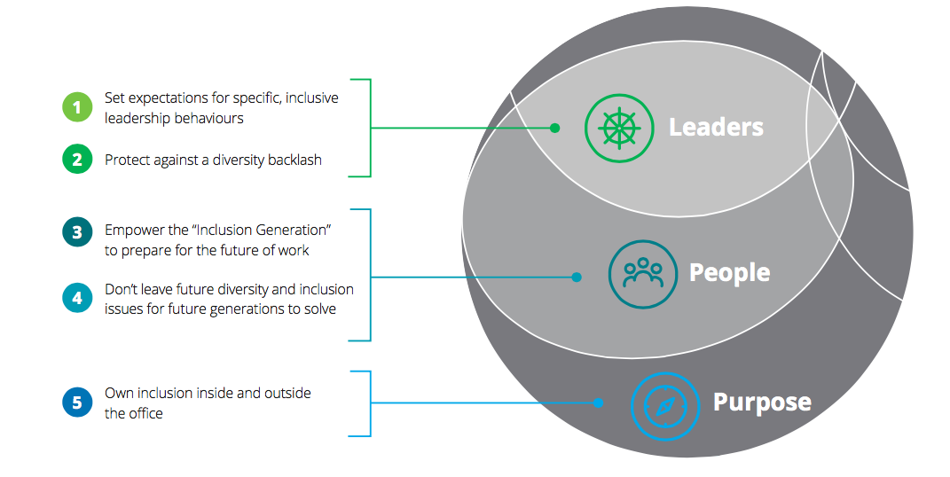
VIGNETTE

Slide 33
When “I” is replaced with “we” even illness becomes wellness
-Malcolm X

Slide 34
Limitations
Perspective (Rosaldo, 1993; Eisner, 1996)
Other racial identity models:
Latino (Yasso, 2006)
American-Indian (Brayboy, 2006)
Bi-racial
Multi-racial
Additional aspects of identity
Duration (Nadal, 2017)

Slide 35
References
Allport, G. W. (1954). The nature of prejudice. Reading, MA: Addison Wesley.
Brewer, M. (2002). The psychology of prejudice: Ingroup love and outgroup hate? Journal of Social Issues, 55(3), 429-444.
Champniss, G., Wilson, H. N., & MacDonald, E. K. (January-February 2015). Why your customer’s social identities matter. Harvard Business Review, January – February 2015. Retrieved from https://hbr.org/2015/01/why-your-customers-social-identities-matter
Cross, W. (1971). The Negro-to-Black conversion experience: Toward a psychology of Black liberation. Black World, 20, 13-27
Cross, W. E. (1978). The Cross and Thomas models of psychological nigrescence. Journal of Black Psychology, 51(1), 13-19.
Deloitte. (2018). Outcomes over optics: Building inclusive organizations. Canada: Author.
Domenech-Rodriguez, M. (2014). No way but through [video file]. Retrieved from https://www.youtube.com/watch?v=2orqr-nOIPk&t=403s
Galliher, R. V., McLean, K. C., & Syed, M. (2017). An integrated developmental model for studying identity content in context. Developmental Psychology, 53(11), 2011-2022.
Helms, J. E. (1990). Black and White racial identity: Theory, research, and practice. Westport, CT: Greenwood Press.
Hogg, M. A. (2001). A social identity theory of leadership. Personality and Social Psychology Review, 5(3), 184-200.
Markus, H., & Wurf, E. (1987). The dynamic self-concept: A social psychological perspective. Annual Review of Psychology, 38, 299-337.
Sherif, M. (1957). Superordinate goals in the reduction of intergroup conflict. American Journal of Sociology, 63(4), 349-356.
Nadal, (2017). “Let’s get in formation”: On becoming a psychologist-activist in the 21st century. American Psychologist, 72(9), 935-946.
Tajfel, H., & Turner, J. C. (1986). The social identity theory of intergroup behavior. Psychology of Inter-Group Relations, 7-24.
Tropp, & Pettigrew (2006). A meta-analytic test of intergroup contact theory. Journal of Personality and Social Psychology, 90(5), 751-783.
Sue, D. W. (2010). Microaggressions in everyday life: Race, gender, and sexual orientation. Hoboken, NJ: Wiley.

Slide 36
THANK YOU!
Lauren H. Mascari, MS, LPC-IT
RP & JL Social Justice Scholar – OCA Wisconsin
Advanced Opportunity Program Fellow
Doctoral Student, Counseling Psychology
University of Wisconsin-Milwaukee
lmascari@uwm.edu
www.hechoenformosa.org

