Slide 1
Community Engagement
Our Restorative Journey
Strengthening the Spirit of Community
Notes:
We will present our Community Engagement strategy in transforming Detroit and it 139 square miles into a Restorative City while honoring its diversity in culture and recognizing already existing neighborhood leadership. This will be accomplished by demonstrating how to conduct a ‘fishbowl’ circle process where everyone involved will be allowed to participate utilizing Fair Process.

Slide 2
Strengthening the Spirit of Community
Strengthening the Spirit
Spirit = Give Life
Give Life to Community
Notes:
Now the Lord is that Spirit. And where the Spirit of the Lord is there is Liberty. (2 Corinthians 3:17)

Slide 3
Notes:
Check in. I’m from Detroit and I’m a fan of our professional sports teams.
When our teams our competing for a championship, the Spirit of Detroit is adorned with their jersey.
Detroit Pistons competed in 2004 and 2005

Slide 4
Notes:
Detroit Red Wings competed in 2009

Slide 5
Notes:
Detroit Tigers competed in 2013. Where are my Detroit Lions fans?

Slide 6
Check in
Your name, your city and community affiliation (if any)
(Circle Keeper, Block Club member/leader, Neighborhood Radio Patrol, etc.)

Slide 7
Strengthening the Spirit of Community
Strengthening the Spirit
Spirit = Give Life
Give Life to Community

Slide 8
BFDI Mission
To strengthen and enhance the lives of children, youth and communities through partnerships that support safe, nurturing vibrant homes, schools and communities
Notes:
Personally involved in Community Engagement with BFDI since I arrived in 2008 working with residents in Osborn, then Cody Rouge. We continue to engage those communities along with Denby and Russell Woods.

Slide 9
BFDI’s 7 Core Commitments
1. Improving the well-being of children 2. Improving academic results 3. Improving neighborhood safety 4. Expanding positive youth development 5. Improving support to families 6. Building community capacity 7. Achieving Promise Neighborhoods Results
Notes:
Personally involved in Community Engagement with BFDI since I arrived in 2008 working with residents in Osborn, then Cody Rouge. We continue to engage those communities along with Denby and Russell Woods.

Slide 10
The Aim of Restorative Practices
To develop community and manage conflict and tensions
By repairing harm and restoring relationships
Notes:
Connect to BFDI Mission
Developing community strategically with residents organizing and sustaining block clubs.
Many block club leaders have received Restorative Practices training and are familiar with the Restorative Practices continuum (informal to formal) and are empowered to manage conflict and tensions that arise in their communities. We now call many of those leaders Restorative Practices Circle Keepers.
The Circle Keepers have been trained in Restorative Practices and they are looked to for neighborhood problem solving which can and often includes repairing harm and restoring relationships.

Slide 11
RESTORATIVE PRACTICES
CIRCLE KEEPERS
A circle is forever.
It never leaves itself, and always returns to itself.
Notes:
Give the essence of the circle.
The circle represents unity, community, etc.

Slide 12
RESTORATIVE PRACTICES
CIRCLE KEEPERS
Circle Keepers are:
Restorative Practices ambassadors in their respective communities;
Circle Keepers are being trained to use Restorative Practices in their homes & families, in their neighborhood, in their Block club meetings, and every space they occupy.
Notes:
Originally focused on the 9th Precinct residents,
Second neighborhood (Cody Rouge) has been identified. Acknowledge Cody Rouge Circle Keepers

Slide 13
RESTORATIVE PRACTICES
CIRCLE KEEPERS
Restorative Practices is the Model
Block club leaders who stepped up to be Restorative Practices Circle Keepers are the Movement
Notes:
Say Model
Say Movement

Slide 14
RESTORATIVE PRACTICES
CIRCLE KEEPERS
Circle Keepers will keep the Circle as a community resource to:
Resolve conflicts;
Engage youth, young adults, and other entities such as schools and businesses; and
Ensure that the Circle (community) is a safe and productive space for all community members.

Slide 15
The Main Idea
People are happier, more productive….when people in positions of authority do things with them rather than to them or for them.
Notes:
They understand the basic idea of Restorative Practices:
The Restorative Practice Circle Keepers are Ambassadors in their communities.
Leaders, people with perceived or real authority.

Slide 16
Cody Rouge Circle Keepers Introduction to Restorative Practices Training

Slide 17
Monthly Community Celebrations
Notes:
Celebrate the Model and the Movement 3 Saturdays a month.
Cody Rouge Networking for Change through Restorative Practices Community Celebration and Luncheon. (westside, 6th Pct),
Osborn (9th Pct. Restorative Practices and Osborn Community Luncheon (9th Pct) and
Denby (9th pct)

Slide 18
Monthly Community Celebrations
Notes:
Celebrate the Model and the Movement 3 Saturdays a month.
Cody Rouge Networking for Change through Restorative Practices Community Celebration and Luncheon. (westside, 6th Pct),
Osborn (9th Pct. Restorative Practices and Osborn Community Luncheon (9th Pct) and
Denby (9th pct)

Slide 19
Monthly Community Celebrations
Notes:
Celebrate the Model and the Movement 3 Saturdays a month.
Cody Rouge Networking for Change through Restorative Practices Community Celebration and Luncheon. (westside, 6th Pct),
Osborn (9th Pct. Restorative Practices and Osborn Community Luncheon (9th Pct) and
Denby (9th pct)
Problem Solving Circles: Elections have Consequences

Slide 20
Derek Blackmon, Sr.
Project Director
Licensed Restorative Practices Trainer

Slide 21
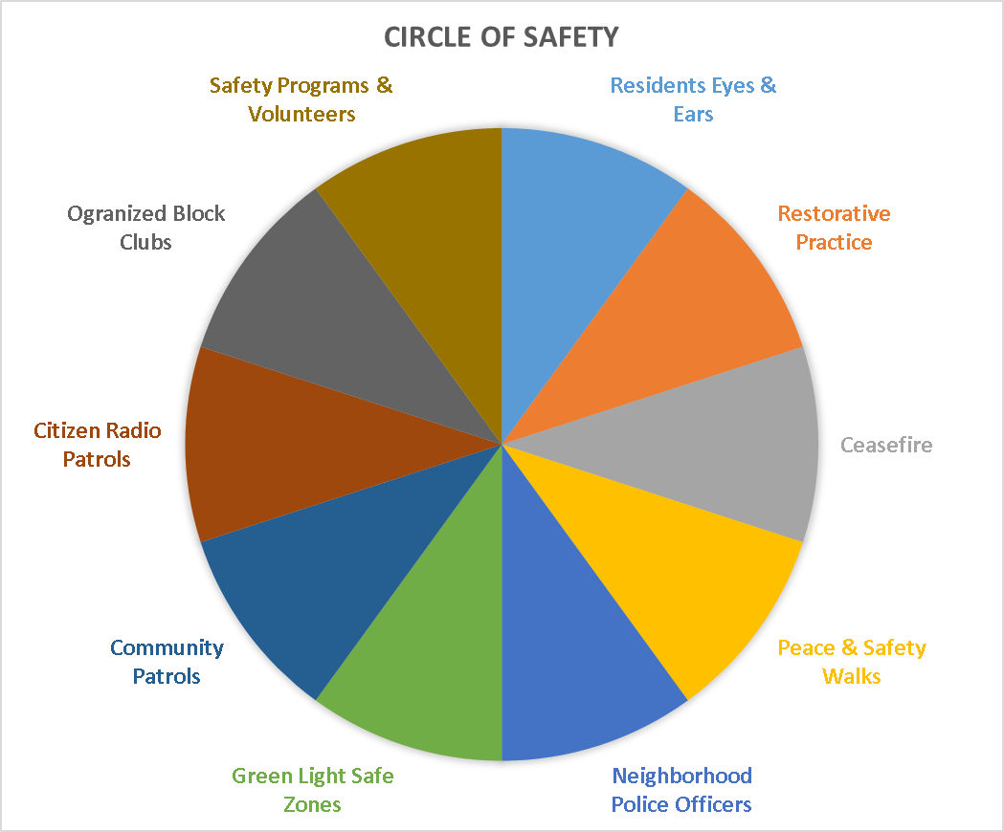
Notes:
Mayor Duggan and Ms. Thompson referred to the Green Light Safe Zone Project and Project Cease Fire
300 businesses
40 % reduction in crime at green light locations.
video surveillance of the Green Light locations including gas stations.
Result: Restorative Spaces and places.

Slide 22
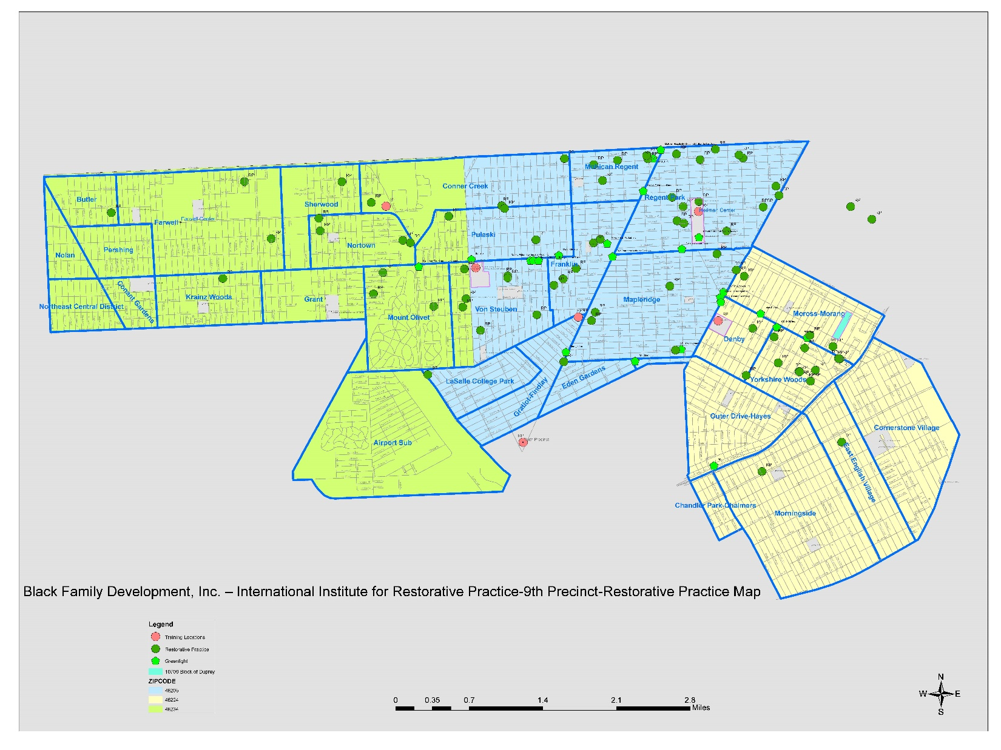

Slide 24
http://www.fox2detroit.com/news/local-news/fed-up-with-crime-residents-protest-detroit-gas-station-to-join-green-light
Notes:
Ensure that link is activated.

Slide 26
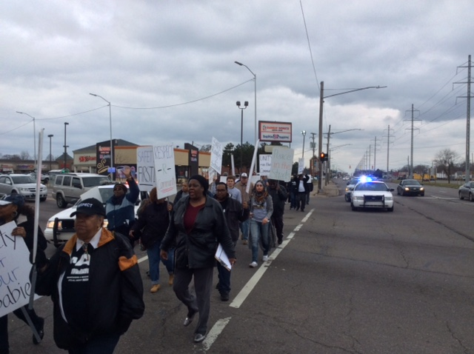

Slide 27
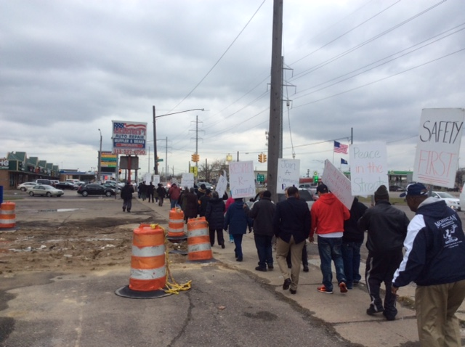

Slide 28
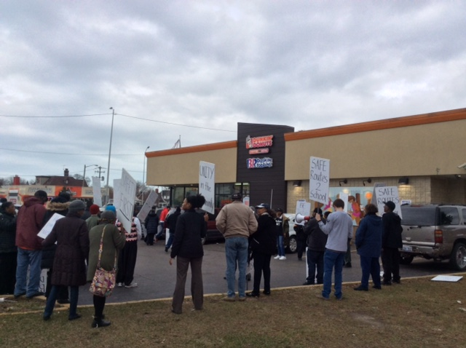

Slide 29
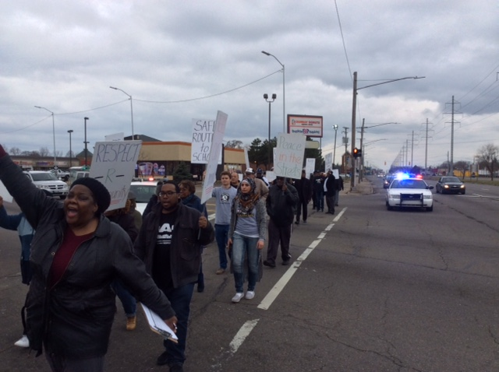

Slide 30
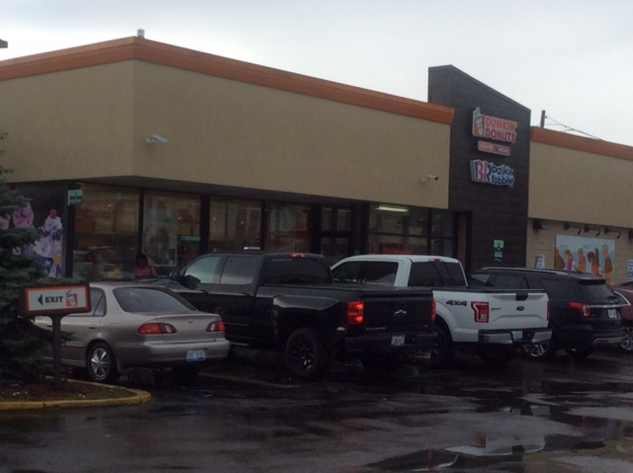

Slide 31
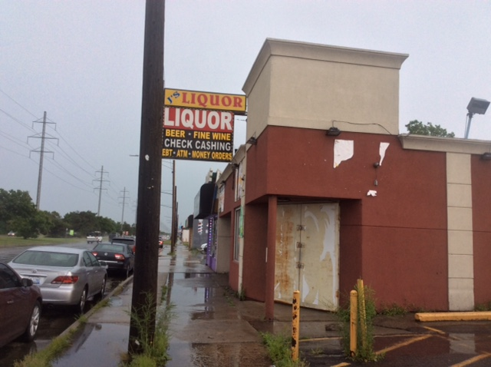

Slide 32
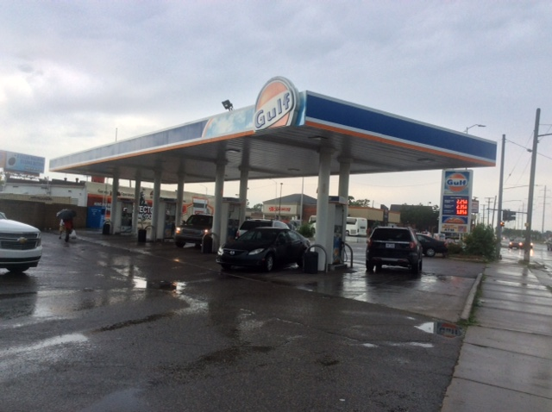

Slide 33
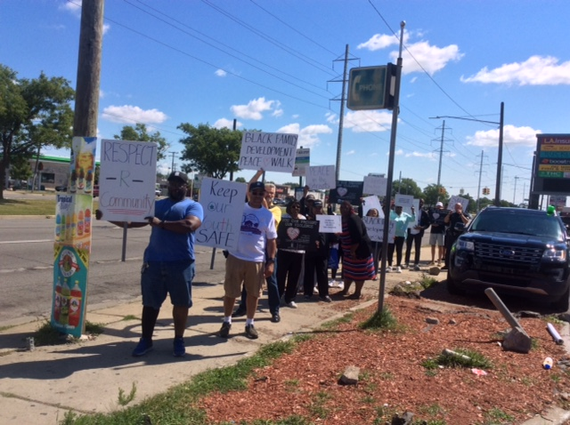

Slide 34
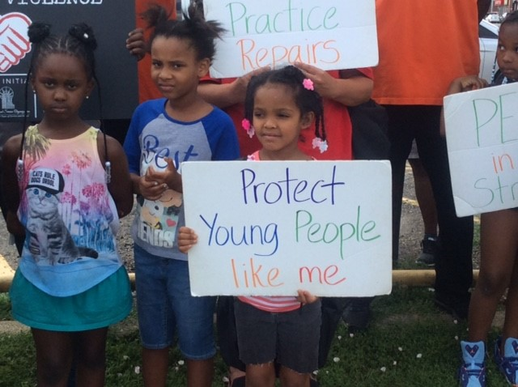

Slide 35
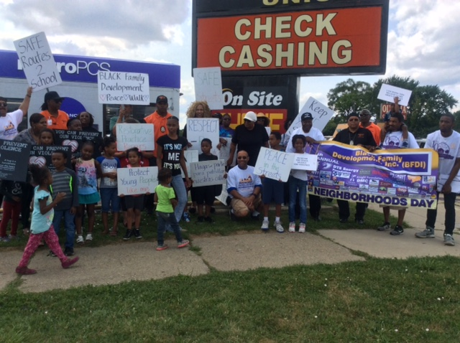

Slide 36
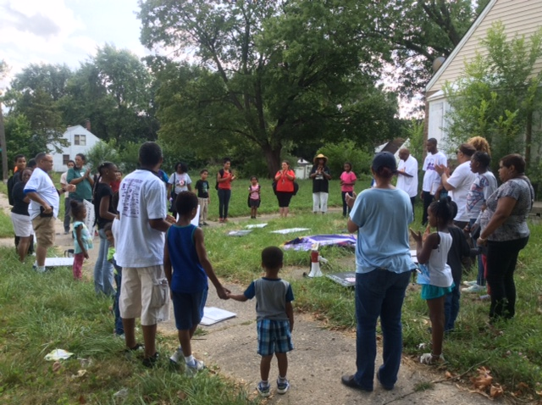

Slide 37
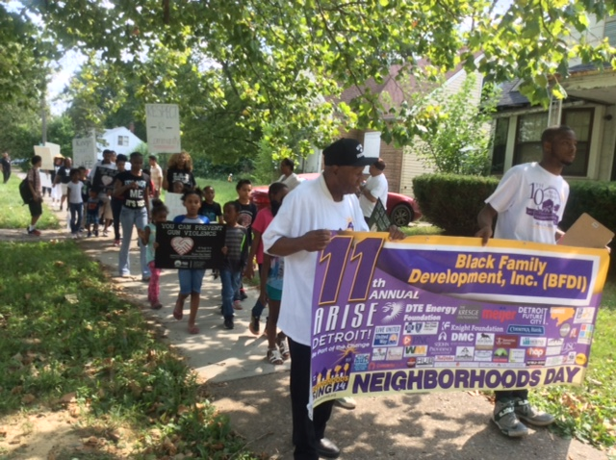

Slide 38
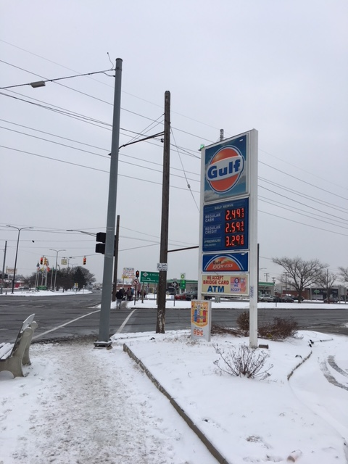

Slide 39
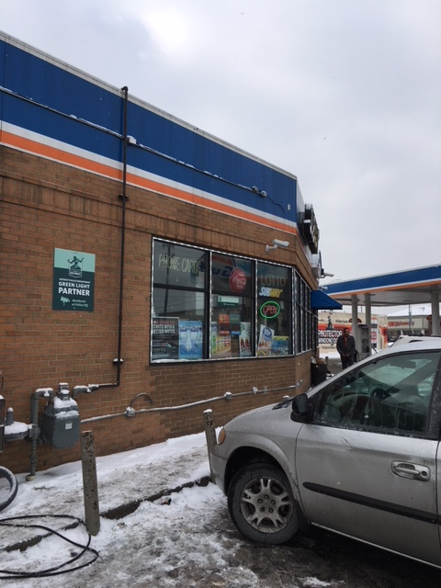

Slide 40
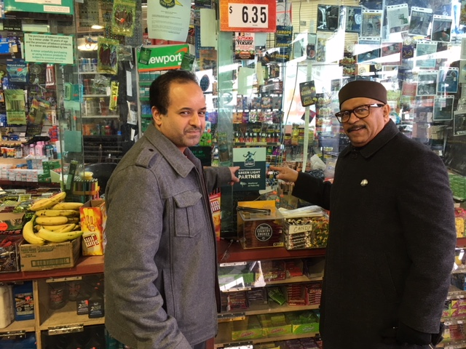

Slide 41
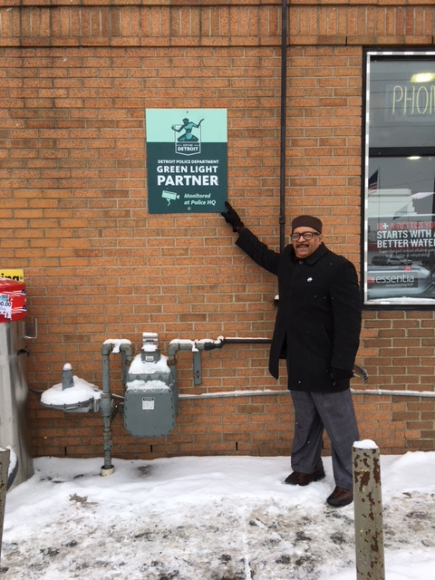

Slide 42
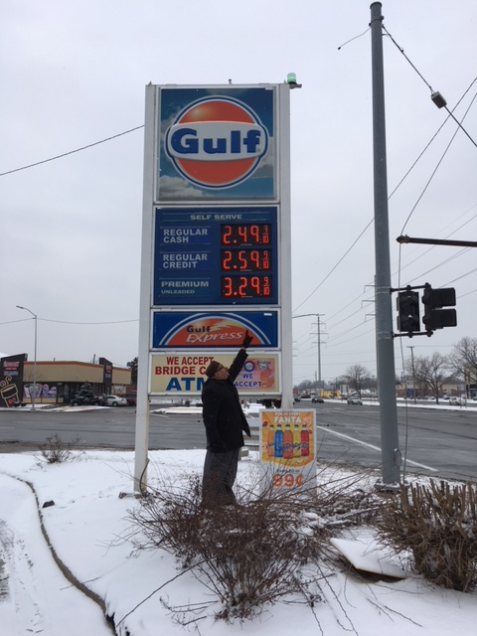

Slide 43
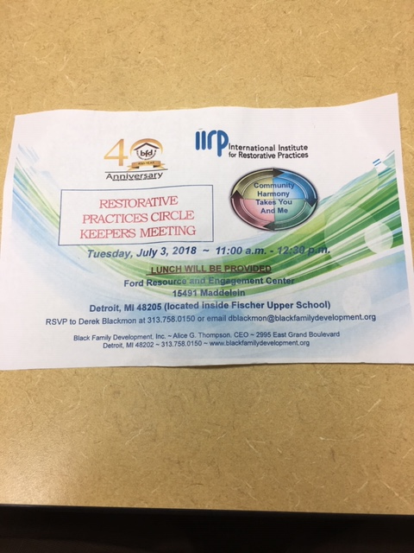

Slide 44
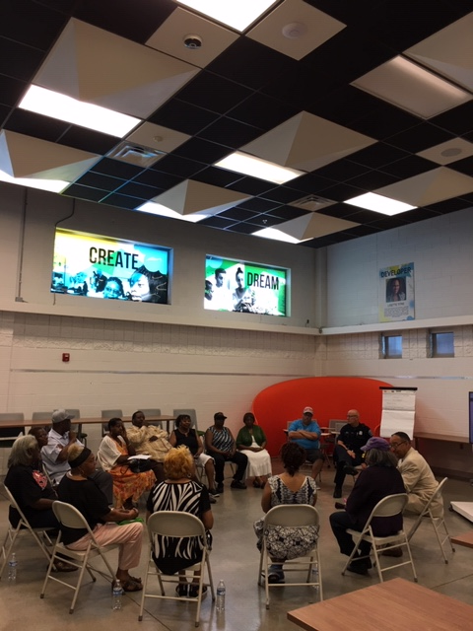

Slide 45
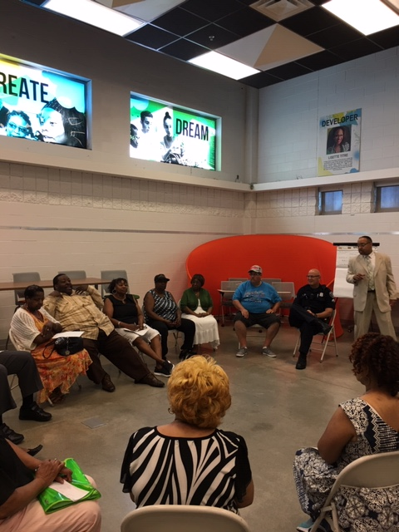

Slide 46
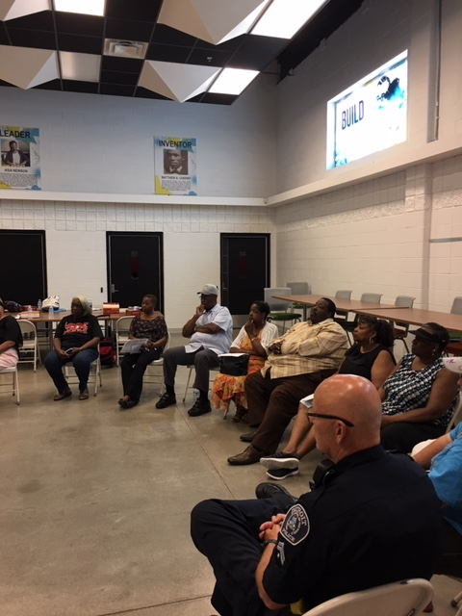

Slide 47
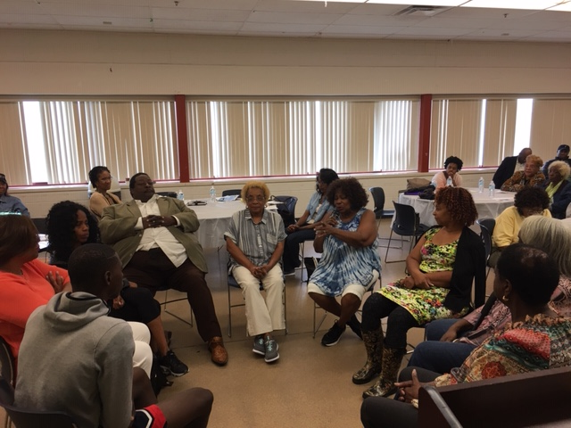

Slide 48
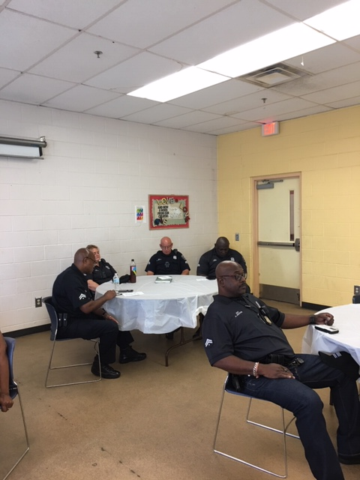

Slide 49
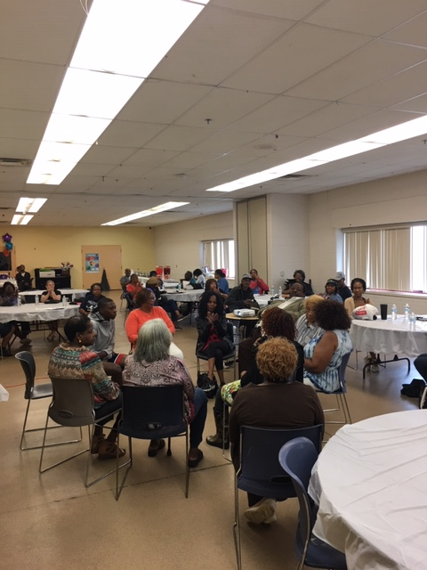

Slide 50
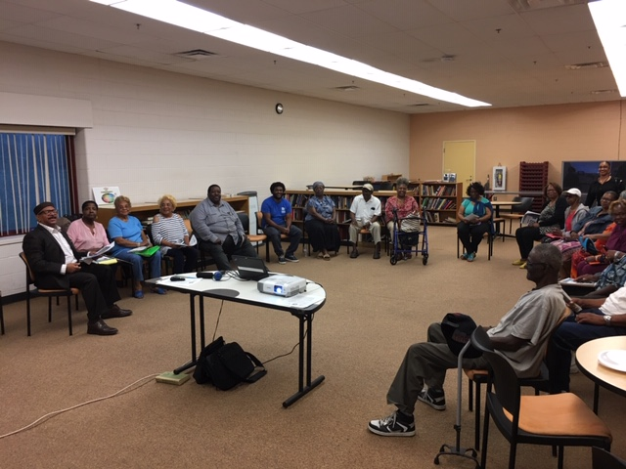

Slide 51
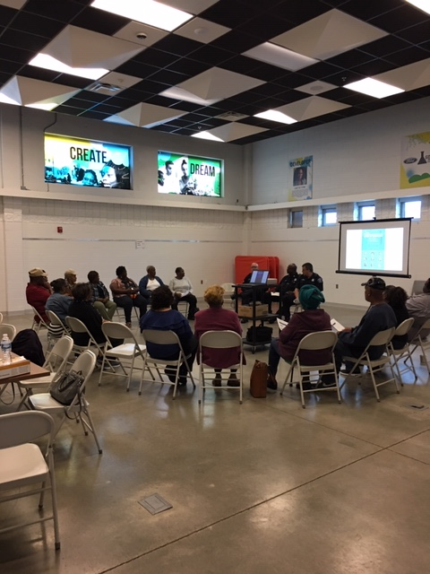

Slide 52
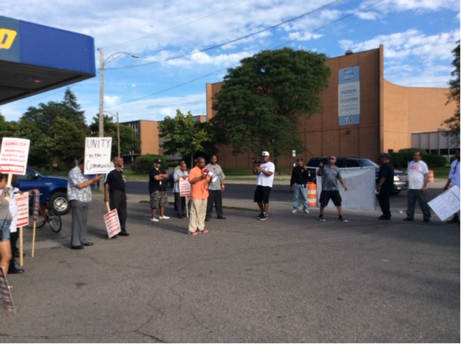

Slide 53
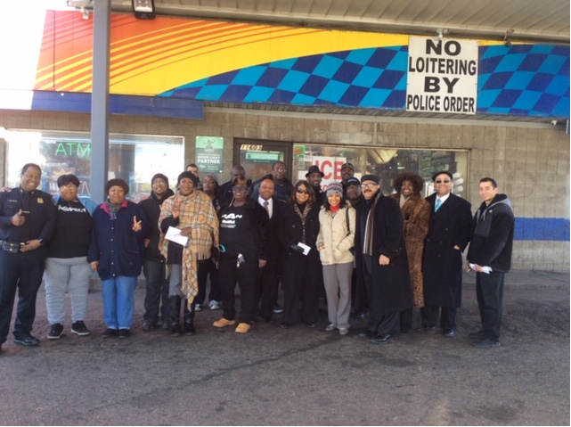

Slide 54
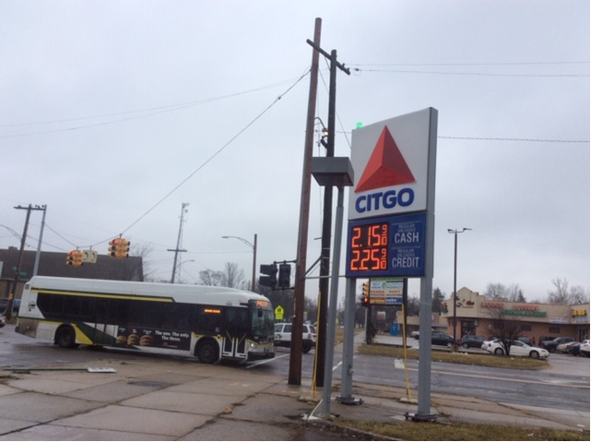

Slide 55
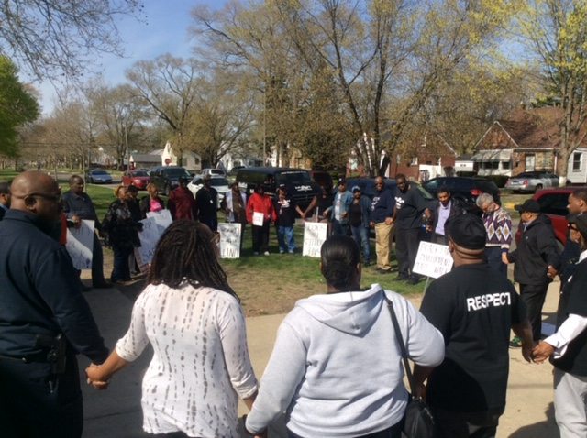

Slide 56
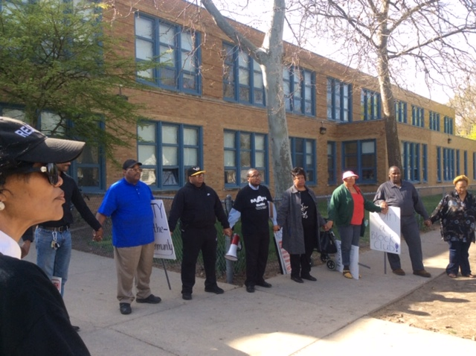

Slide 57
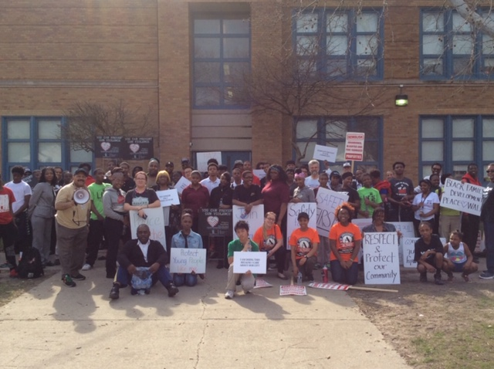

Slide 58
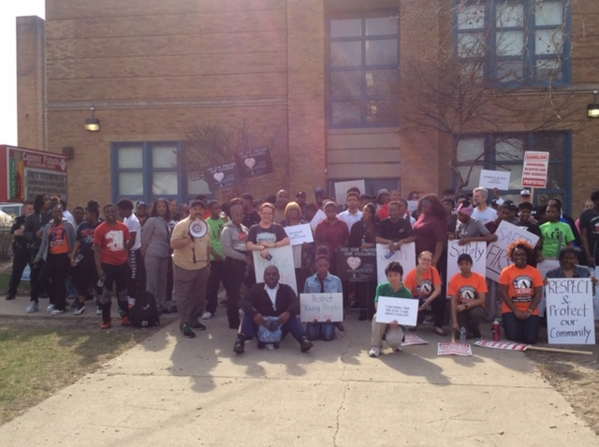

Slide 59
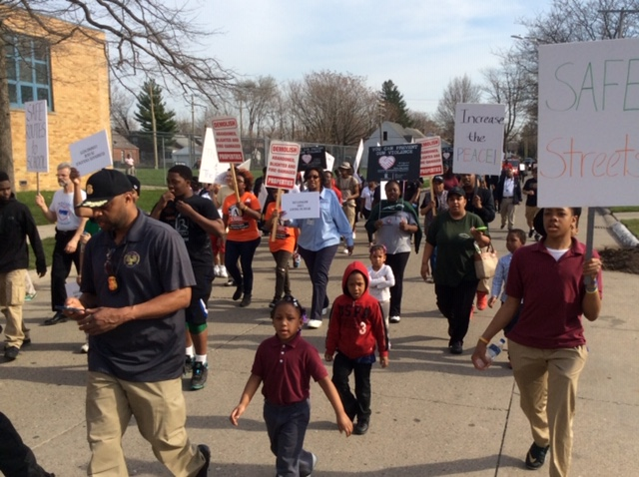

Slide 60
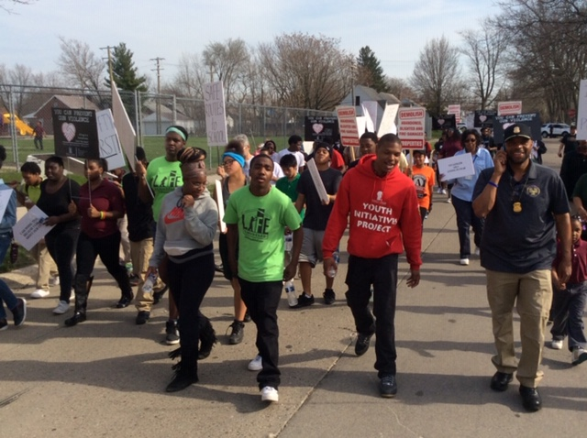

Slide 61
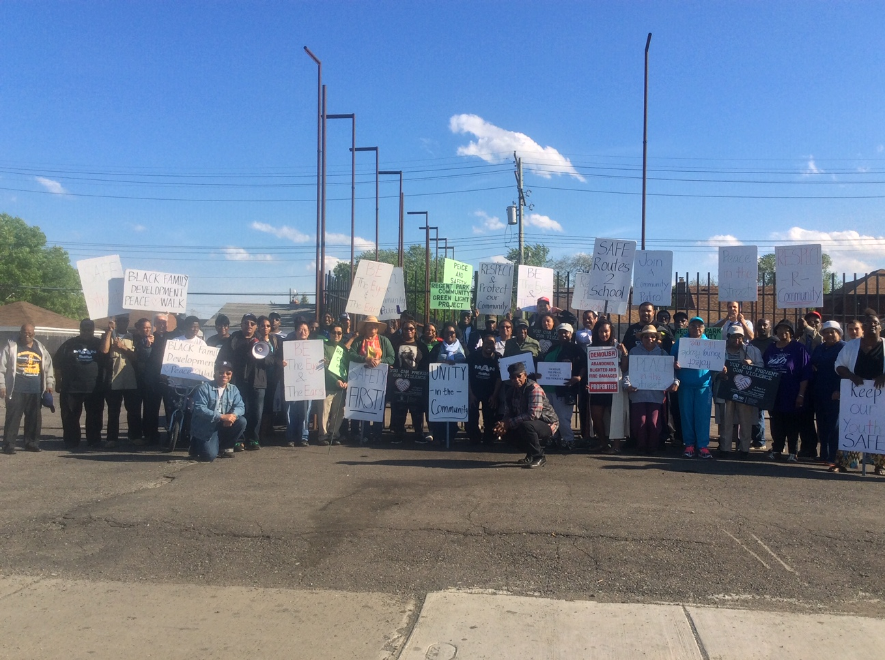

Slide 62
Thank you
Derek Blackmon, Sr. Project Director (313)758-0150 dblackmon@blackfamilydevelopment.org
Kevin Bryant Program Manager (313)758-0150 kbryant@blackfamilydevelopment.org

